Slide 1
USCoders
Carolina Souza, Derek Lim, Kartik Balodi, Kelly Huang, Rohan Sanjay
Notes:
Kartik start

Slide 2
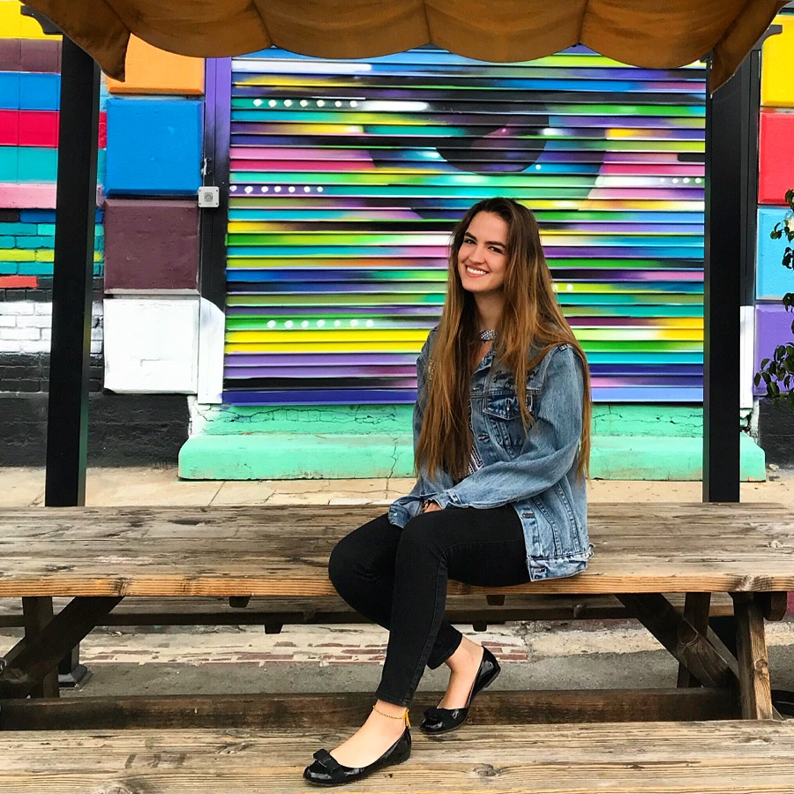

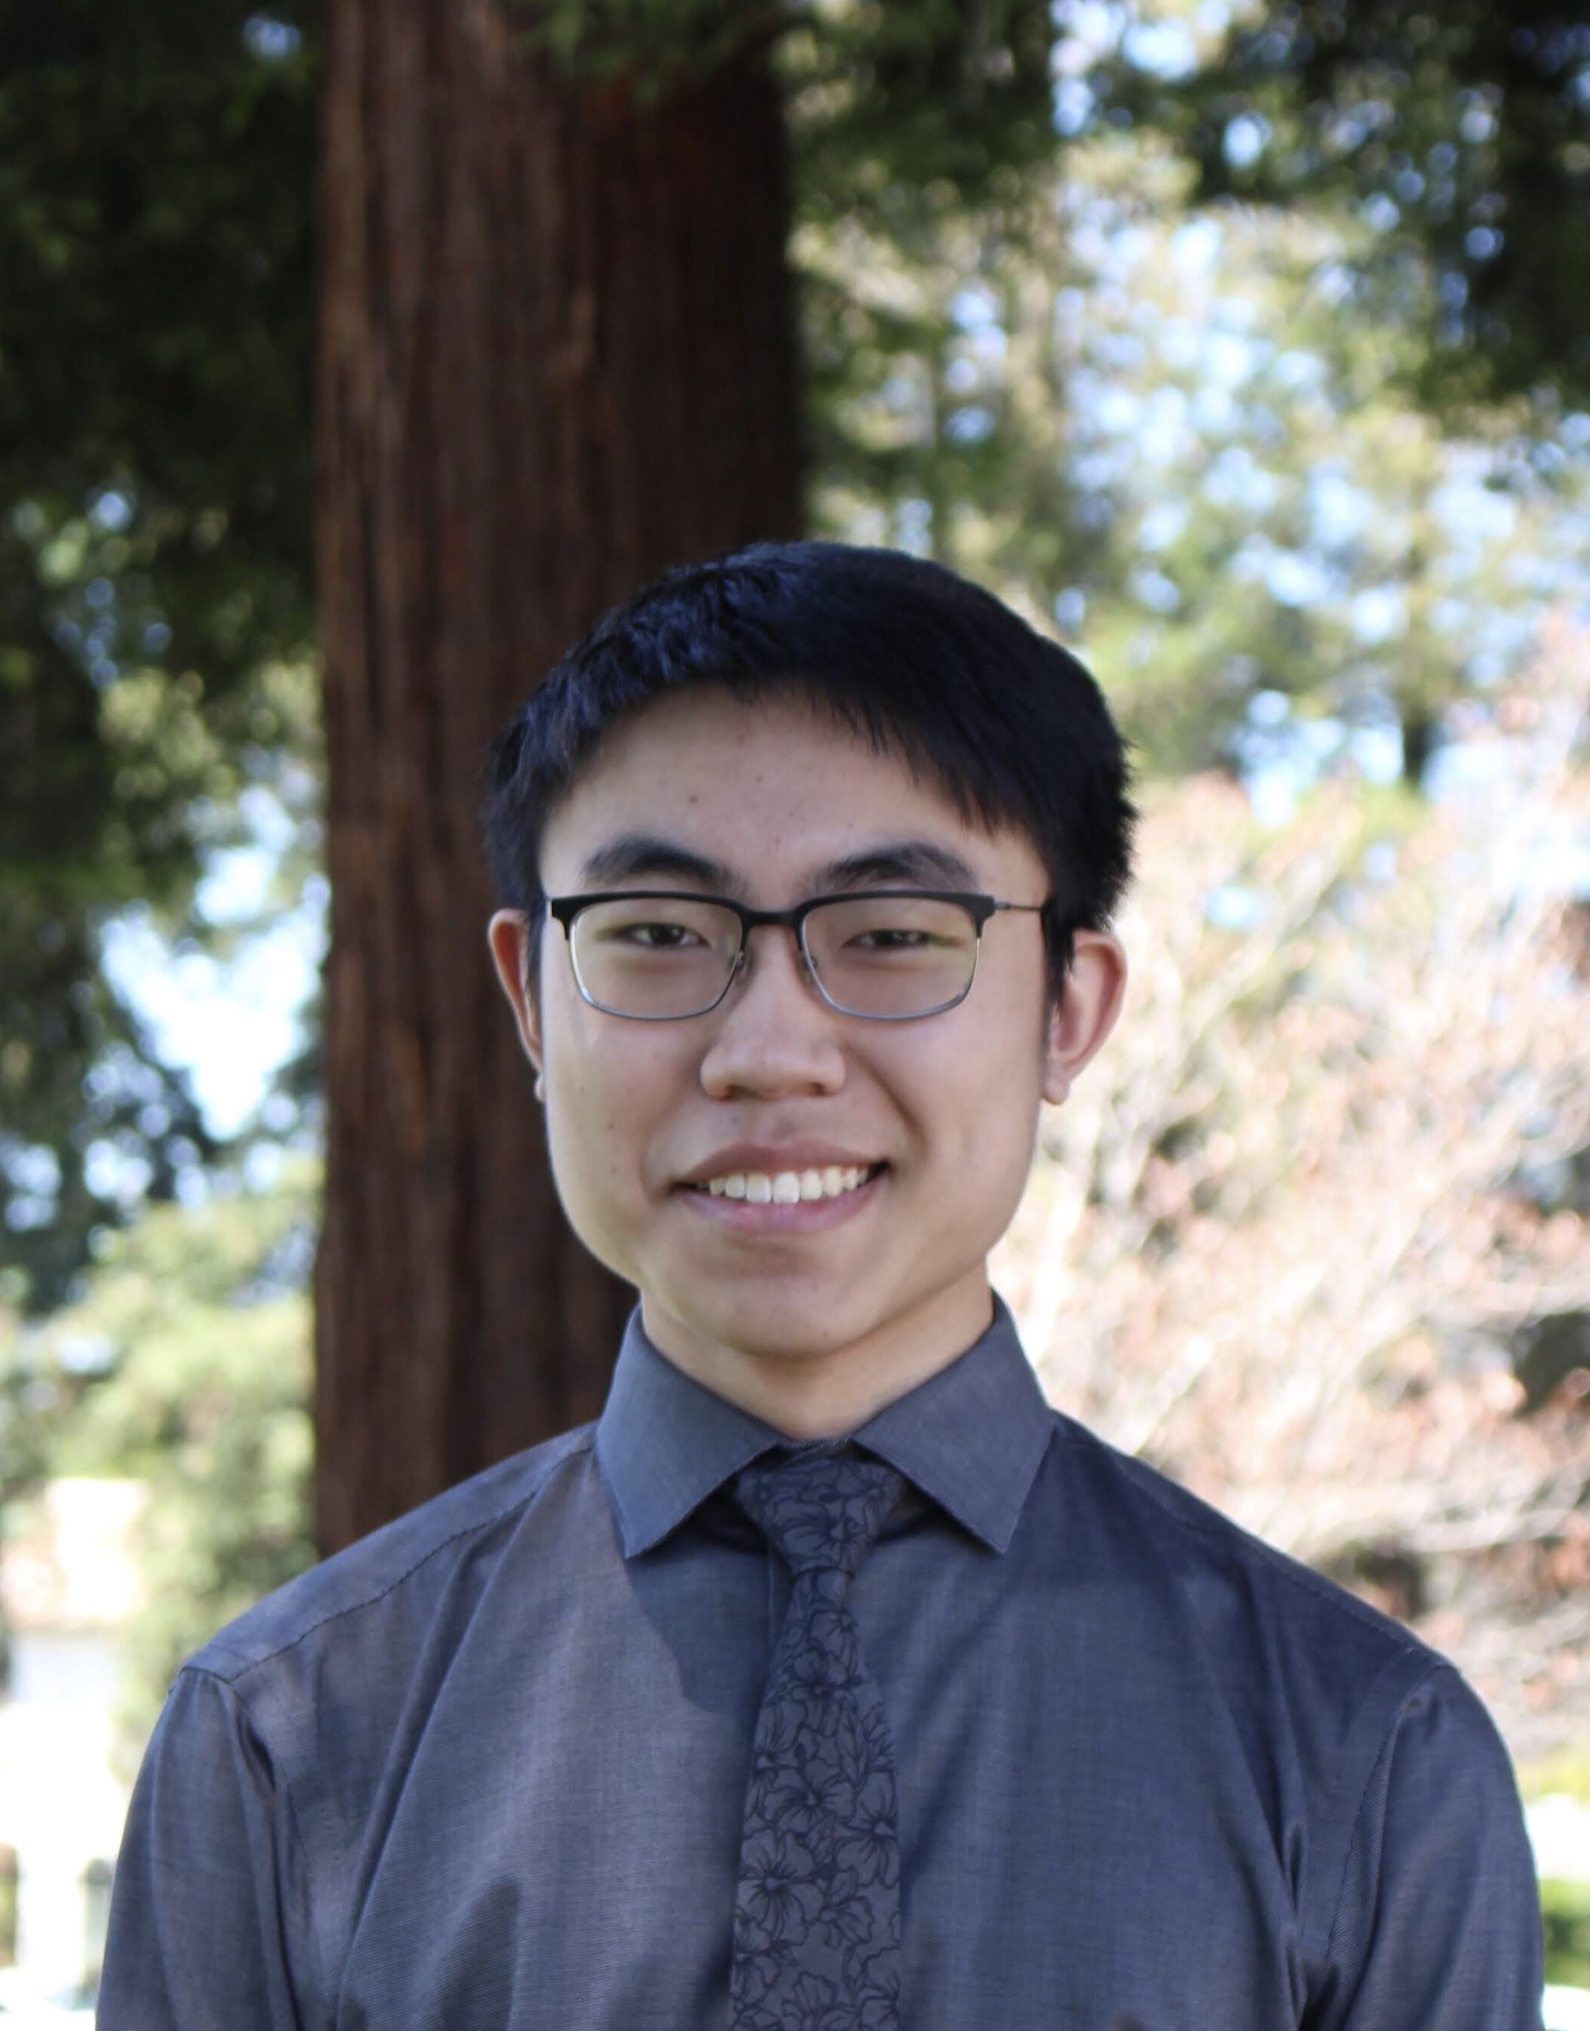
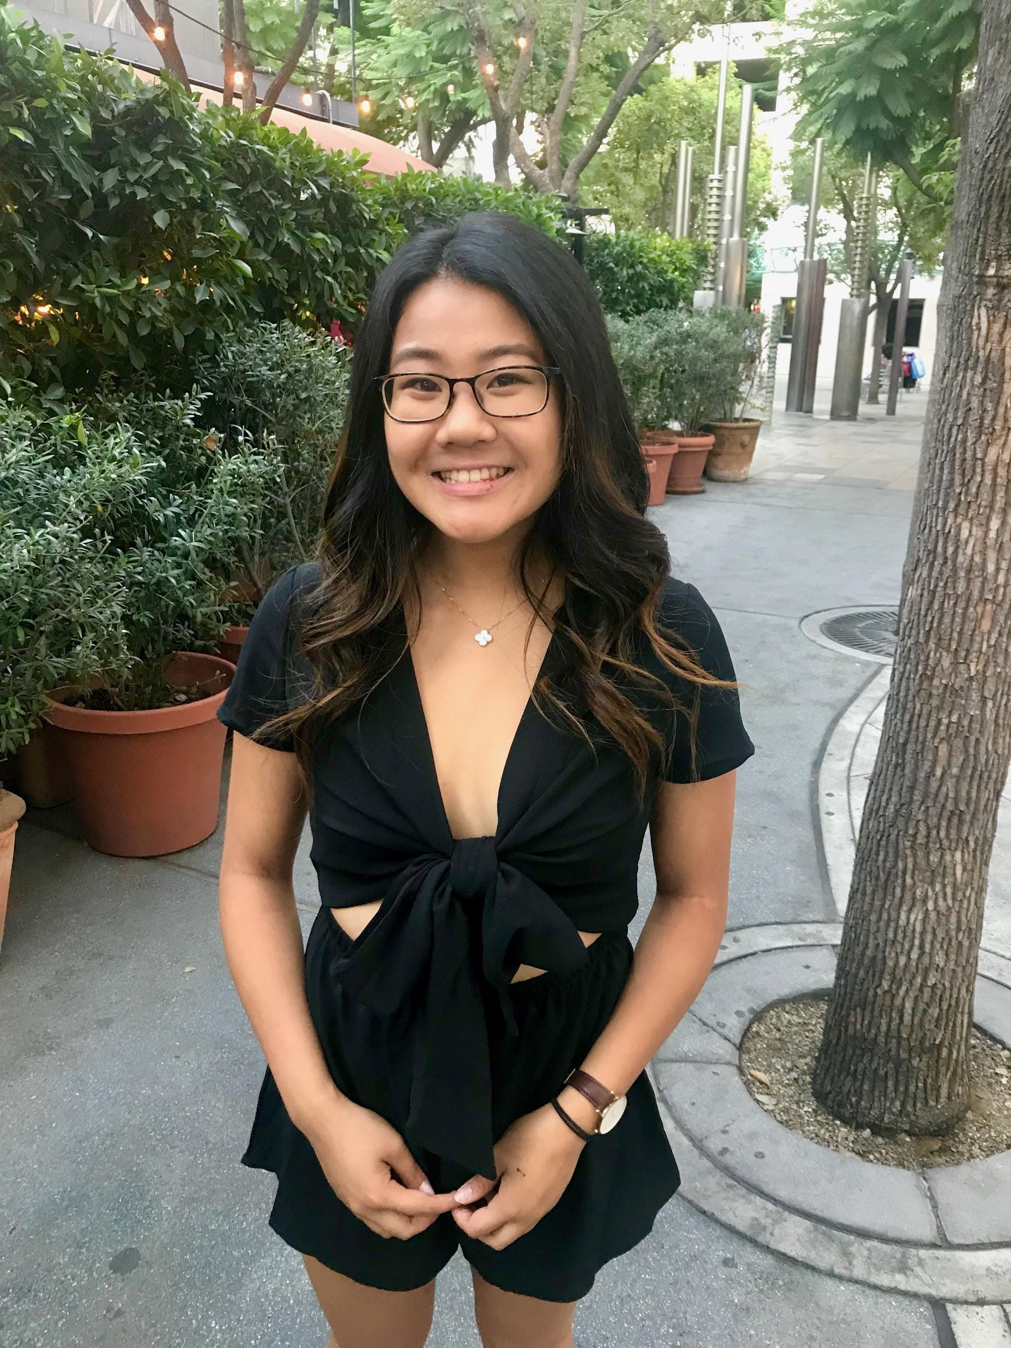
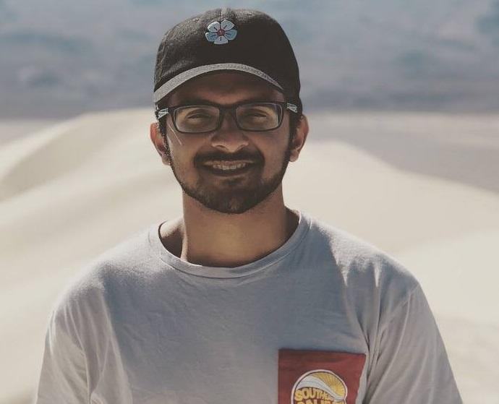
Team

Slide 3
The problem
Want to filter for:
Two or fewer person case
One or two people in the image
One person case
Only one person in the image

Slide 4
Our Objectives
We are looking at cropping the pictures instead of simply resizing to increase accuracy of our model.
We will implement keras and mobilenet on the case of pictures with one person for now. Our group hopes to expand the model to cases of two or fewer eventually.
At the end of the project, we hope to have a model constructed with 80% or greater accuracy.
Notes:
Kartik end

Slide 5
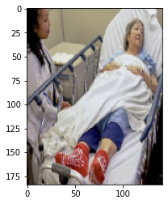
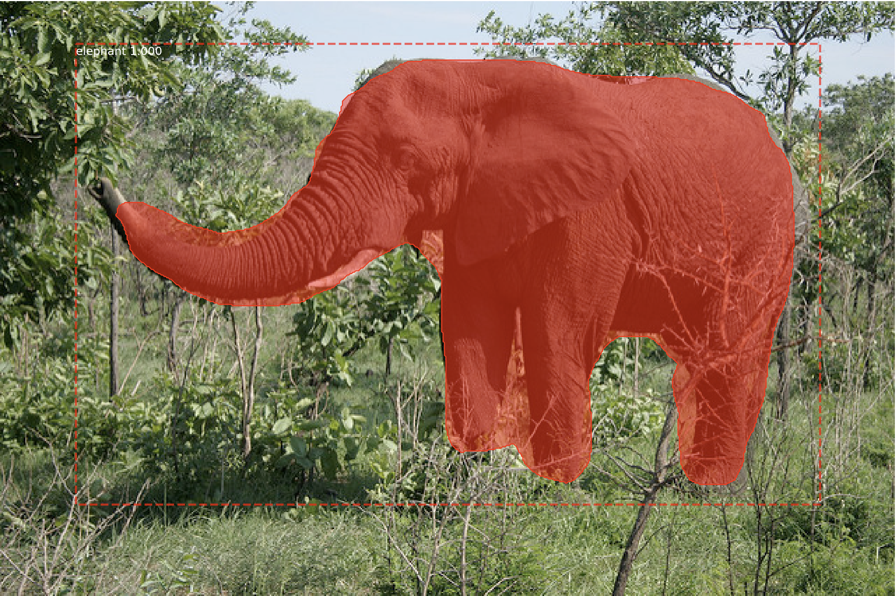
Object Detection x Image Segmentation
The task of image segmentation is to train a neural network to output a pixel-wise mask of the image.
Object detection is a computer vision technique that allows us to identify and locate objects in an image or video.
Notes:
Carolina

Slide 6
Mobilenet V2
MobileNet-v2 is a convolutional neural network that is 53 layers deep.
You can load a pre-trained version of the network trained on more than a million images from a ImageNet database
The pretrained network can classify images into 1000 object categories, such as keyboard, mouse, pencil, and many animals
Notes:
Carolina

Slide 7
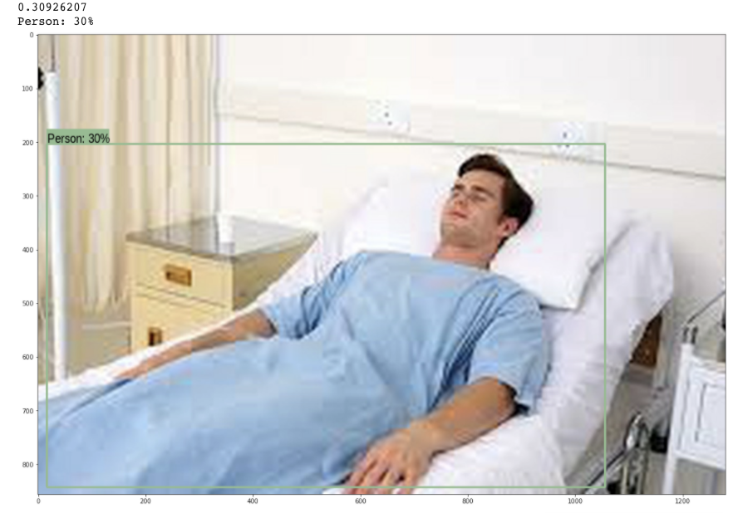
COCO Object Detection
Notes:
Rohan

Slide 8
Next Steps
Create a pipeline for our own data sets and analyze performance
Test other available detection classes (90 available)
Crop images using bounding boxes and train classification model to see if accuracy improves
May need to optimize speed
Notes:
Rohan

Slide 9
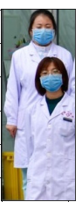
Two(+) People:
Human Pose Skeleton Approach?
Notes:
Derek
https://towardsdatascience.com/detection-free-human-instance-segmentation-using-pose2seg-and-pytorch-72f48dc4d23e
A lot of object detection methods will treat overlapping bounding boxes as redundant

Slide 10
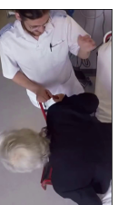
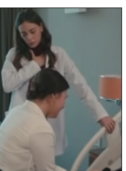
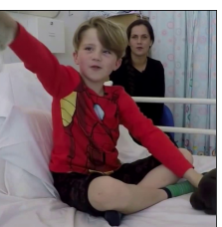
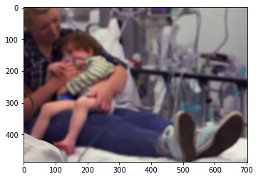
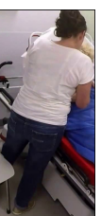
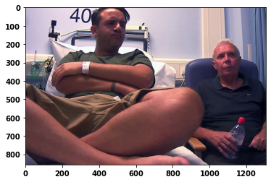
“Two People” + “Not Occluded”
1
3
4
2
(Negligible / No Overlap)
Less Overlap
Complete Overlap
(1 Person?)
Notes:
Derek
Define overlap
Explain spectrum and extremes
X% of one person’s bounding box overlapped by the other

Slide 11
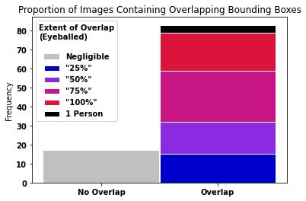
Notes:
Derek
When we shift focus to two person cases, it may be useful to think about using the human pose skeleton approach…
With such a large proportion of images that have overlapping bounding boxes, it might be harder to classify with that approach

Slide 12
Questions？

Slide 13
Object Detection with Mask R-CNN
What is Mask R-CNN?
a deep neural network aimed at object detection and instance segmentation used on top of Keras and Tensorflow
creates a bounding box for where the object is within the image
Why is this important?
Use bounding box to crop image instead of simply resizing
Hope to create better accuracy this way so that images don’t get stretched or distorted in the resizing process

